Slide 1
PRESENTED BY: NAME :THOKKUDUBIYYAPU. SUVEDITHA BLESSY COLLEGE : RAMACHANDRA COLLEGE OF ENGINEERING BRANCH :COMPUTER SCIENCE OF ENGINEERING Final Project

Slide 2
PROJECT TITLE: KEY LOGGER AND SECURITY
3/21/2024 Annual Review

Slide 3
KeyLogger&Security Keyloggers are a type of surveillance software that record every keystroke made on a computer's keyboard. They can be used both for legitimate purposes, like monitoring employee activity, and for malicious purposes, such as stealing passwords and other sensitive information. Hardware Keyloggers:Physical devices attached to the computer, typically between the keyboard and the computer or within the keyboard itself. They capture keystrokes directly from the hardware. Software Keyloggers:Software Keyloggers are malicious programs or applications installed on a computer system that are designed to covertly monitor and log the keystrokes made by users. These logs can include sensitive information such as usernames, passwords, credit card numbers, and personal messages.

Slide 4


AGENDA
Problem statement
Project overview
Who are the end users?
Solution and its value proposition
The wow in your solution
Modelling
Results
Project Link
3/21/2024 Annual Review

Slide 5

PROBLEM STATEMENT
Keyloggers, both hardware and software, pose significant security threats by secretly recording every keystroke made on a computer. This clandestine activity can lead to severe consequences, including data theft, financial loss, and identity theft. While hardware keyloggers require physical access to the device, software keyloggers can be installed remotely through malicious downloads, email attachments, or exploiting software vulnerabilities. Detecting and preventing keyloggers is a critical aspect of maintaining cybersecurity in personal, business, and government environments.
To develop effective methods for detecting and preventing the installation and operation of malicious software keyloggers on computer systems, thereby protecting sensitive user information and ensuring data integrity and privacy.
3/21/2024 Annual Review

Slide 6

PROJECT OVERVIEW
Objective:
The primary objective of this project is to understand the mechanisms of keylogging for educational purposes and develop security measures to prevent, detect, and mitigate such threats. This project will provide a comprehensive understanding of how keyloggers operate, how they can be detected, and the various strategies to secure systems against them.
Key Components:
Detection Mechanisms:
Signature-based Detection: Develop signatures for known keyloggers and use antivirus-like methods to detect them.
Behavioral Analysis: Monitor system behaviors that may indicate the presence of a keylogger, such as unusual file access patterns or unexpected network traffic.
2. Mitigation Techniques:
Response Plans: Develop plans for responding to the detection of a keylogger, including system isolation, data recovery, and forensic analysis.
User Education: Create educational materials to inform users about the dangers of keyloggers and how to avoid them.
3/21/2024 Annual Review

Slide 7

WHO ARE THE END USERS?
1.Cybercriminals
Purpose: Stealing sensitive information such as passwords, credit card numbers, and personal data.
Usage: Deploy keyloggers as part of phishing attacks, malware, or social engineering schemes.
2.Employers
Purpose: Monitoring employee activity for productivity, security, or policy compliance.
Usage: Use keyloggers to track keystrokes on company-owned devices to ensure appropriate use of resources.
3.Law Enforcement Agencies
Purpose: Conducting investigations and gathering evidence.
Usage: Utilize keyloggers as part of surveillance operations to track criminal activities or gather intelligence.
3/21/2024 Annual Review

Slide 8

YOUR SOLUTION AND ITS VALUE PROPOSITION
To provide a solution to protect against key loggers effectively, we need to consider a multi-layered approach that encompasses both preventive measures and detection techniques. Here’s a structured solution:
Enhanced Security: Provides proactive monitoring and detection of suspicious activities that could compromise security, helping organizations and individuals protect sensitive information.
Regulatory Compliance: Helps organizations comply with industry regulations and standards by ensuring proper monitoring and logging of user activities.
Early Threat Detection: Enables early detection of insider threats, cyber attacks, or abnormal behavior through detailed analysis of keystroke patterns and user activities.
Customization and Control: Offers customizable settings and controls for tailoring monitoring levels according to specific needs and preferences, ensuring flexibility and effectiveness.
3/21/2024 Annual Review

Slide 9

THE WOW IN YOUR SOLUTION
1. Behavioral Analysis and Anomaly Detection:
AI-Based Behavioral Monitoring: Utilize AI algorithms to analyze user behavior and identify deviations that could indicate key logger activities. AI can learn normal patterns of keystrokes and detect anomalies in real-time, triggering alerts or preventive actions.
Pattern Recognition: Train AI models to recognize typical keystroke patterns and distinguish them from suspicious or malicious patterns associated with key loggers. This helps in early detection and proactive mitigation.
2.Machine Learning for Adaptive Protection:
Continuous Learning: Implement machine learning models that continuously learn from new data to improve detection capabilities against evolving key logger techniques. This adaptive approach enhances the solution's effectiveness over time.
Anomaly Detection: Train AI models to detect anomalous behaviors related to key logging across various endpoints and environments, adapting to new attack vectors and scenarios.
3/21/2024 Annual Review
9

Slide 10
MODELLING
Modeling key loggers involves understanding their behavior, characteristics, and methods of operation in order to detect and mitigate their impact effectively. Here's how key loggers can be modeled:
1. Classification Based on Functionality:
Hardware vs. Software Key Loggers: Differentiate between key loggers that are implemented as physical devices (hardware key loggers) and those that are software-based (software key loggers).
Functionality: Classify key loggers based on their primary function, such as logging keystrokes, capturing screenshots, recording clipboard contents, or intercepting data from input devices.
2. Detection Methods and Evasion Techniques:
Signature-Based Detection: Identify key loggers based on known patterns or signatures derived from their code or behavior. Signature-based detection relies on databases of known key logger definitions.
Behavioral Analysis: Analyze the behavior of applications and processes to detect deviations indicative of key logging activities. This includes monitoring for unusual file access, network traffic, or system registry changes.
3/21/2024 Annual Review
10

Slide 11

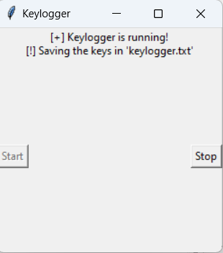
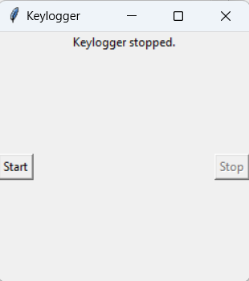
RESULTS
3/21/2024 Annual Review
11

Slide 12
PROJECT LINK
https://github.com/shaiksadiya123/sadiya_project.git

